Slide 1
Fashion Hub
Developed By :
Guided By :
Harsora Harsh (3704)
Dr. Hardik Gangadwala
Itailiya Tirth (3850)
Golakiya Krinj (3840)

Slide 2
Index

Slide 3
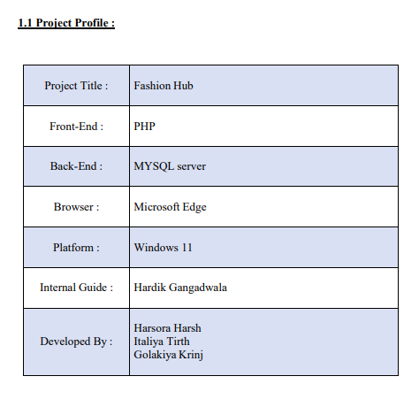
Project Profile

Slide 4
Project Description
Online shopping is a form of electronic commerce which allows consumers to directly buy product from a seller over the Internet using a web browser.
Fashion Hub System is a web application that is mainly use to sell product. This System providing many facilities like Product management, order management, add to cart, Payment management, etc....

Slide 5
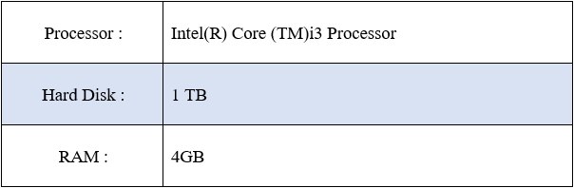
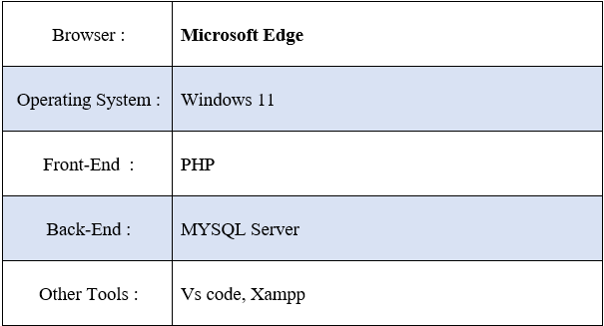
Hardware And Software Requirements
Hardware Requirements :
Software Requirements :

Slide 6
Objective And Purpose
This system is developed to fulfil the requirement of the online shopping of products.
This system very gracefully handles the entries requirement for easily shopping of products which is facilitate category and subcategory wise.
Display all the categories on the home page, that are associated with any particular item.
Admin can login into the system and can access the all events, add products. add category, add subcategory, add city/state and also can change the details respectively.
Provide the system administrator with easy interface for different administrative task such as addition, updating and deletion of different entities.
Registered user will be able see the details of different types of items details (like: color), category wise or subcategory wise products, etc.

Slide 7
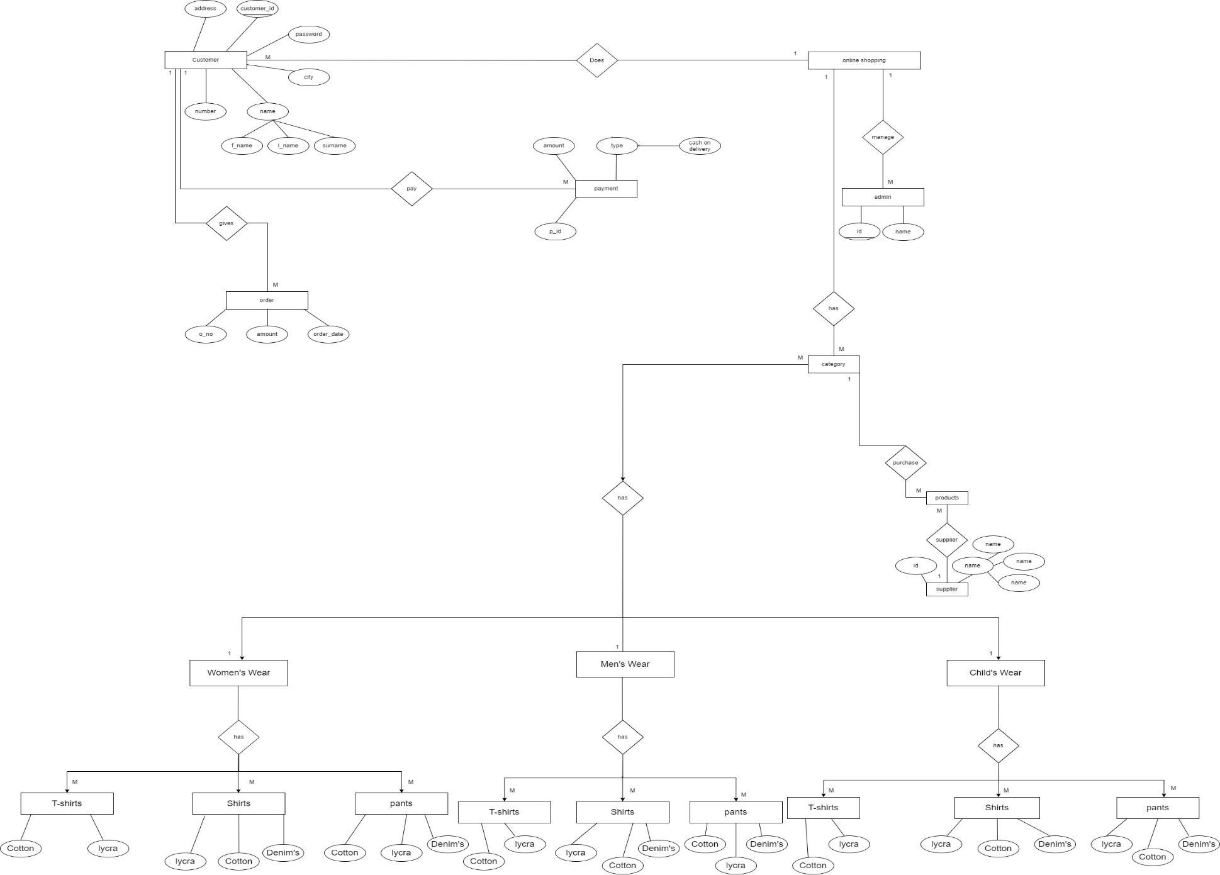
Entity Relationship Diagram

Slide 8
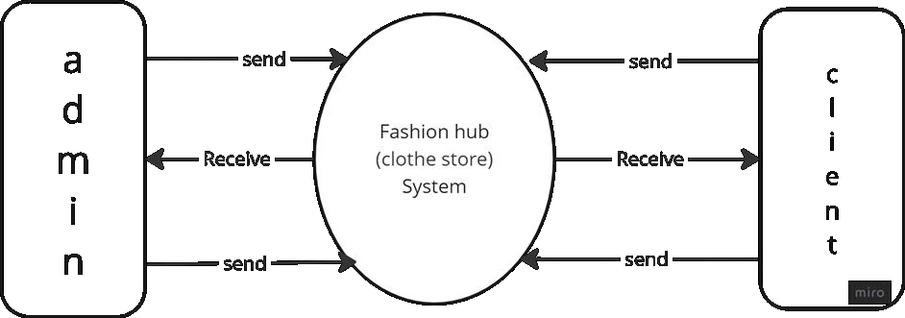
DFD 0 Level (user)

Slide 9
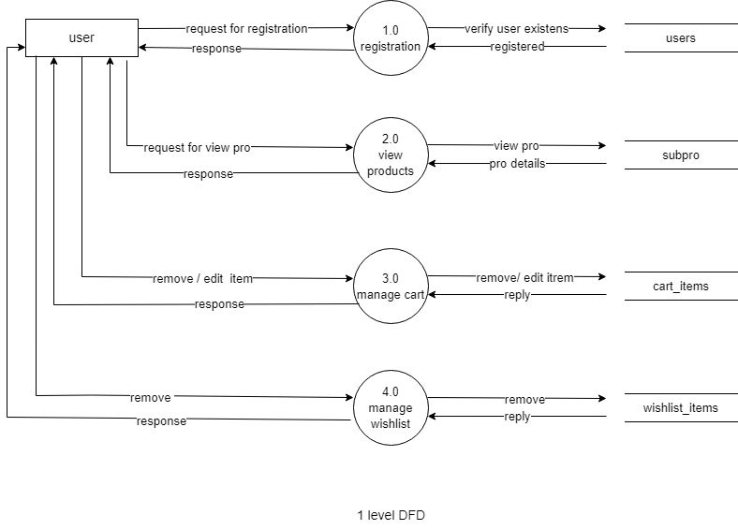
DFD 1st level (user)

Slide 10
DFD 0 Level

Slide 11
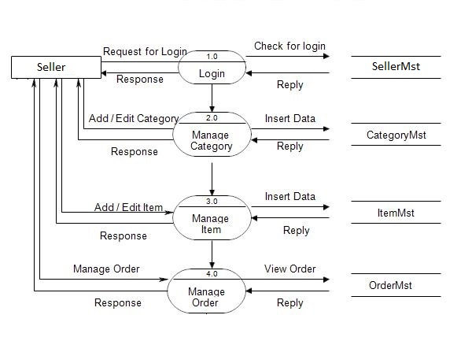
DFD 1st level

Slide 12
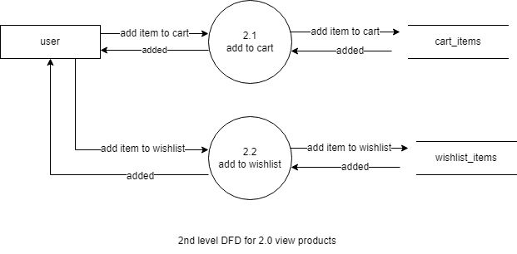
DFD 2nd level (user)

Slide 13
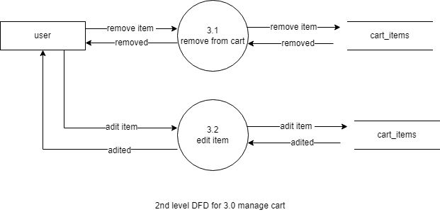
DFD 2nd level

Slide 14
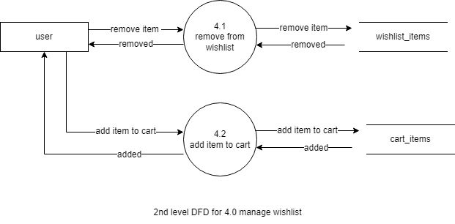
DFD 2nd level

Slide 15
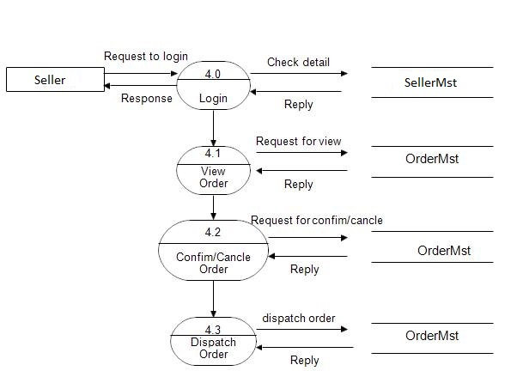
DFD 2nd level

Slide 16
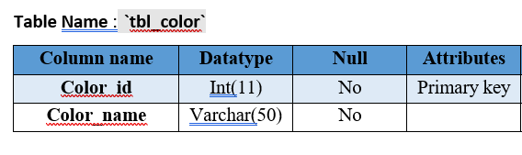
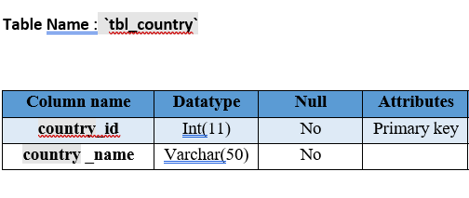
Database Design

Slide 17
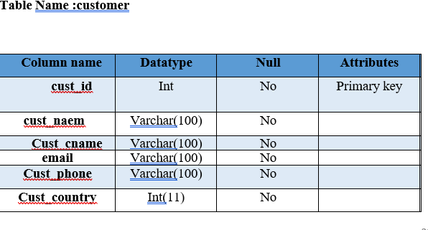
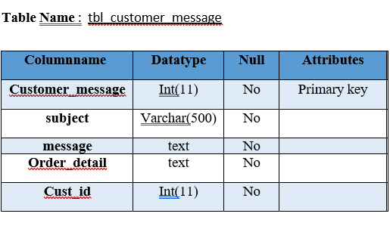
Database Design

Slide 18
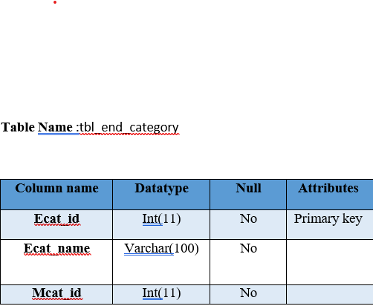
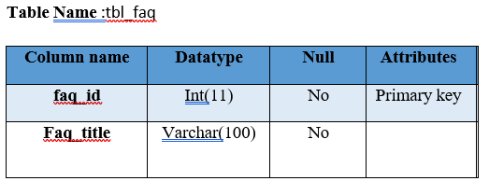
Database Design

Slide 19
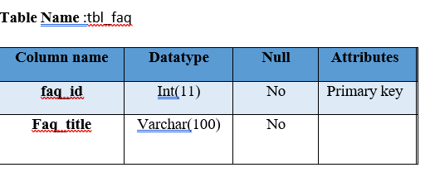
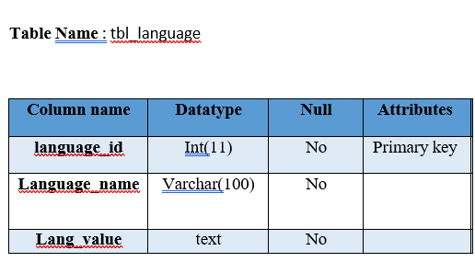
Database Design

Slide 20
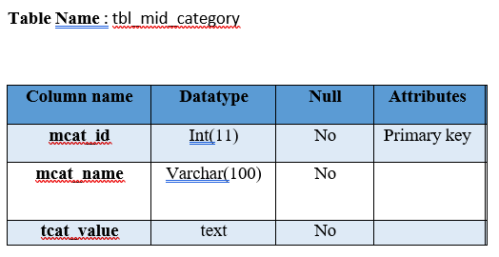
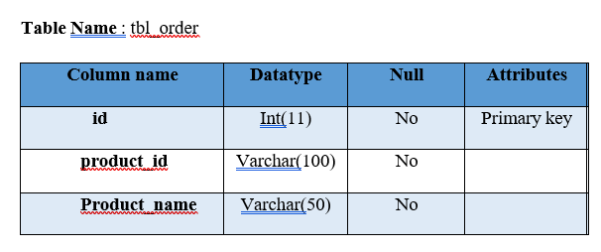
Database Design

Slide 21
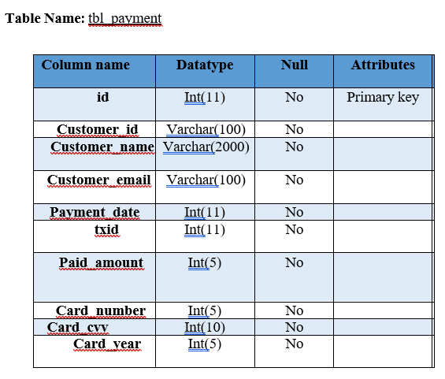
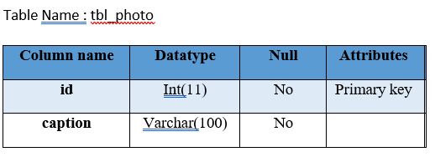
Database Design

Slide 22
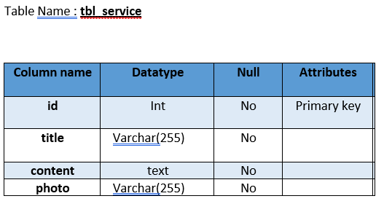
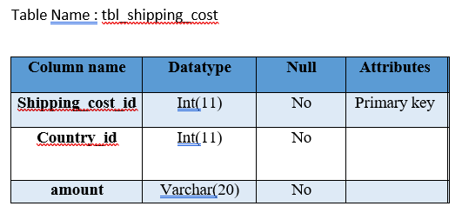
Database Design

Slide 23
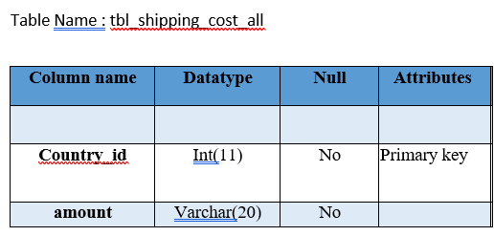
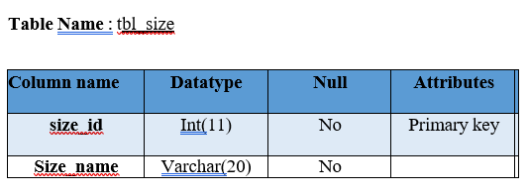
Database Design

Slide 24
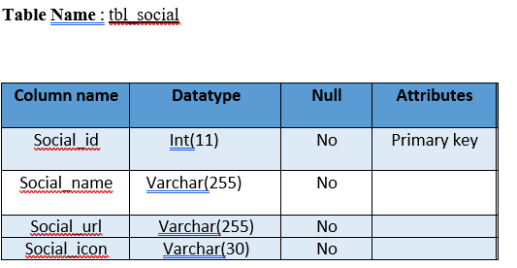
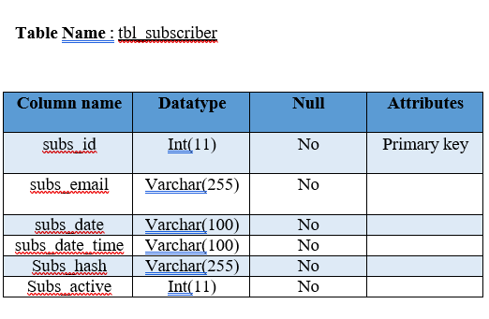
Database Design

Slide 25
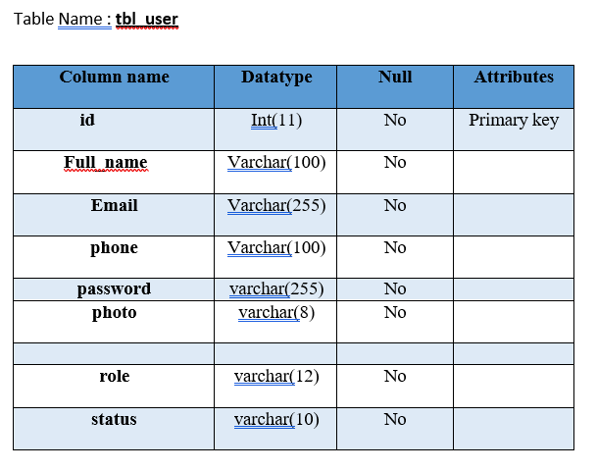
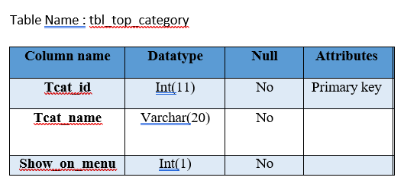
Database Design

Slide 26
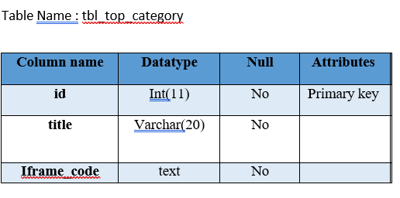
Database Design

Slide 27
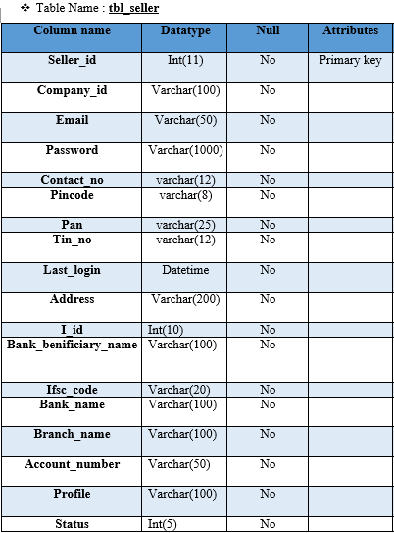
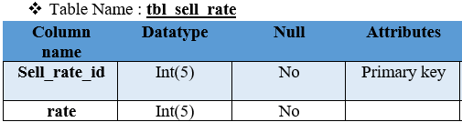
Database Design

Slide 28
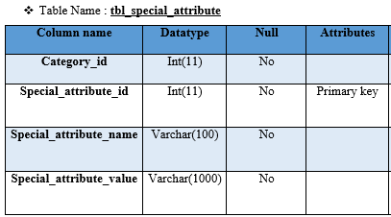
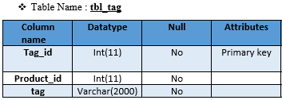
Database Design

Slide 29
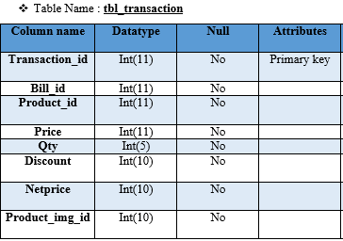
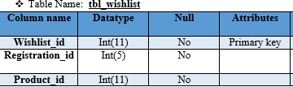
Database Design

Slide 30
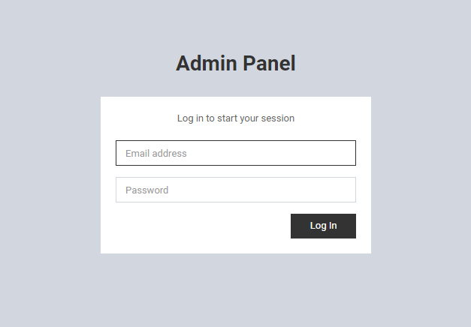
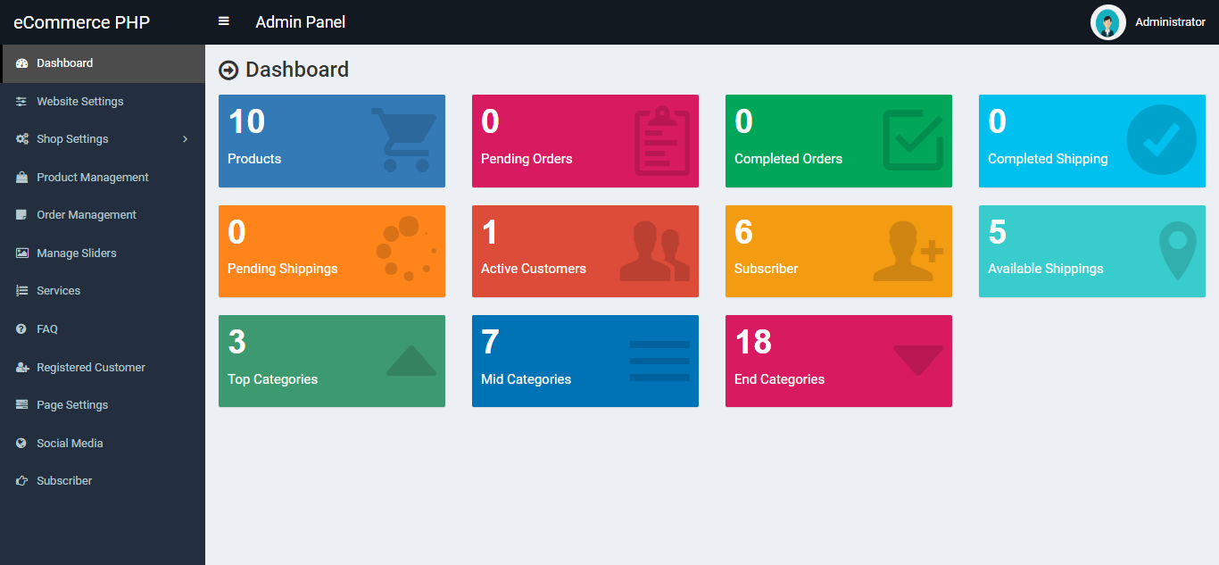
System Design
Admin site
Login :
Dashboard :

Slide 31
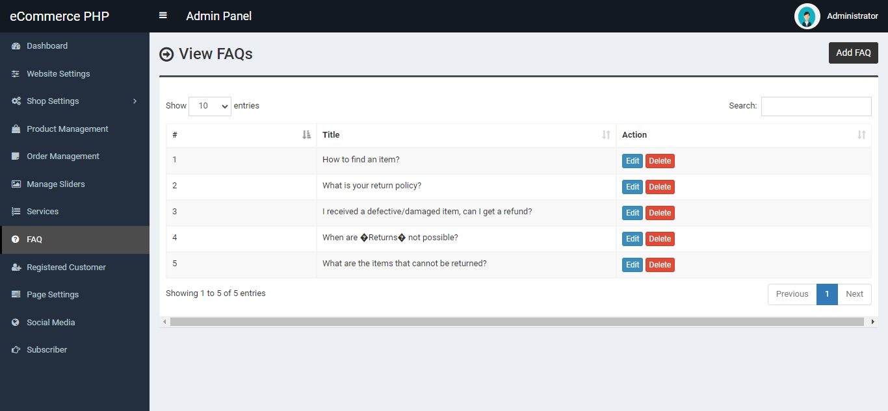
Feedback :

Slide 32
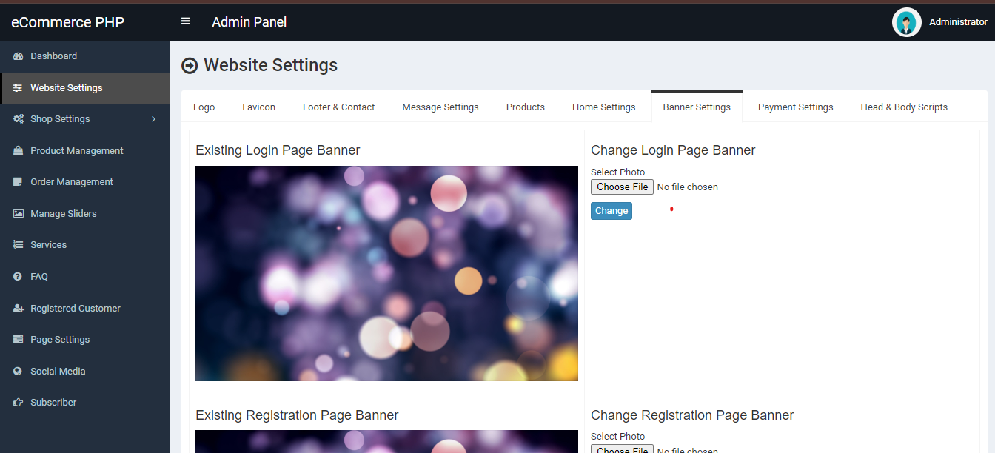
Banner :

Slide 33
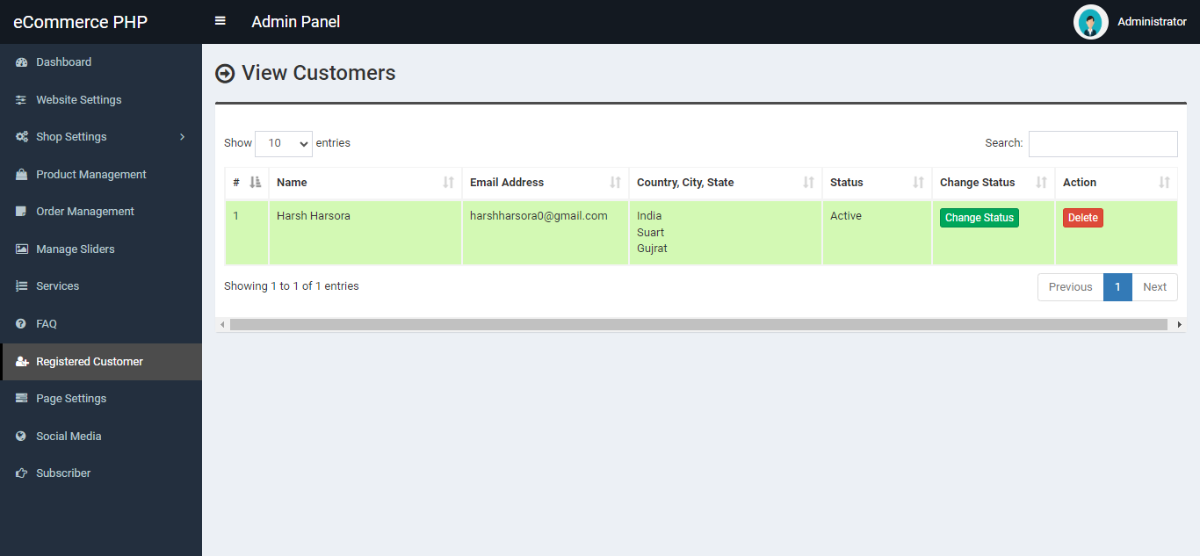
User list :

Slide 34
Seller list :

Slide 35
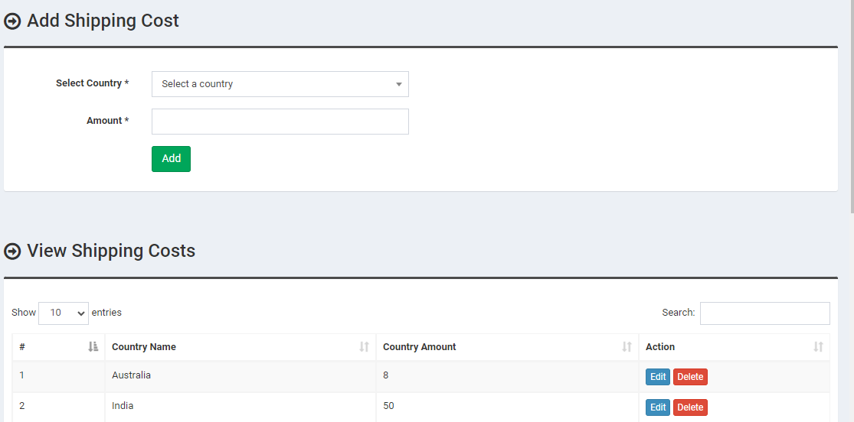
Location :

Slide 36
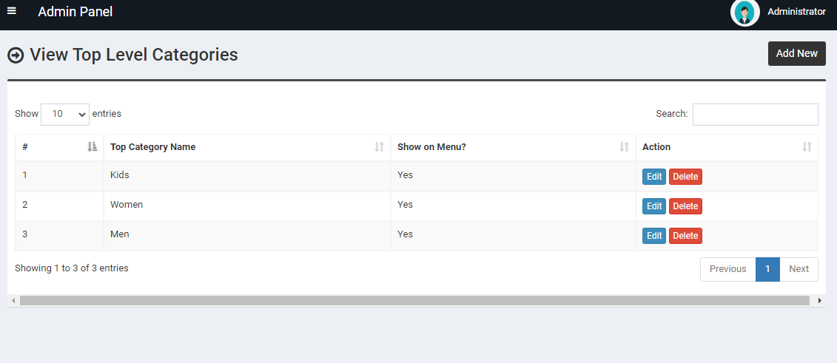
Add Category :

Slide 37
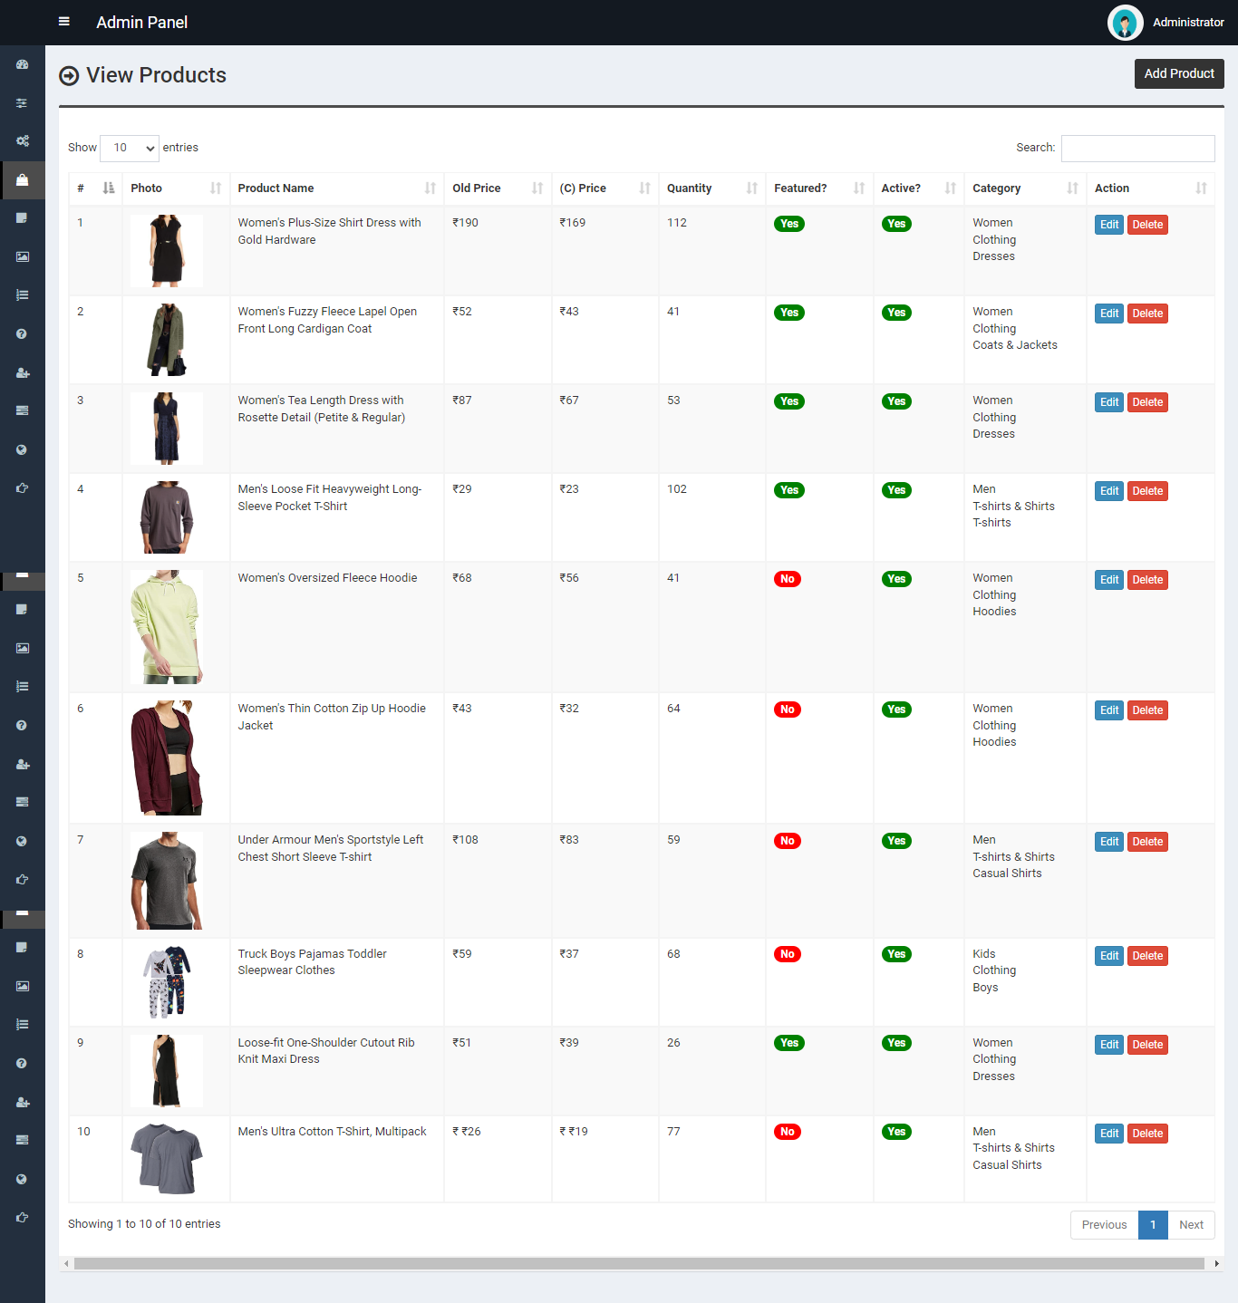
Active / DE active Products :

Slide 38
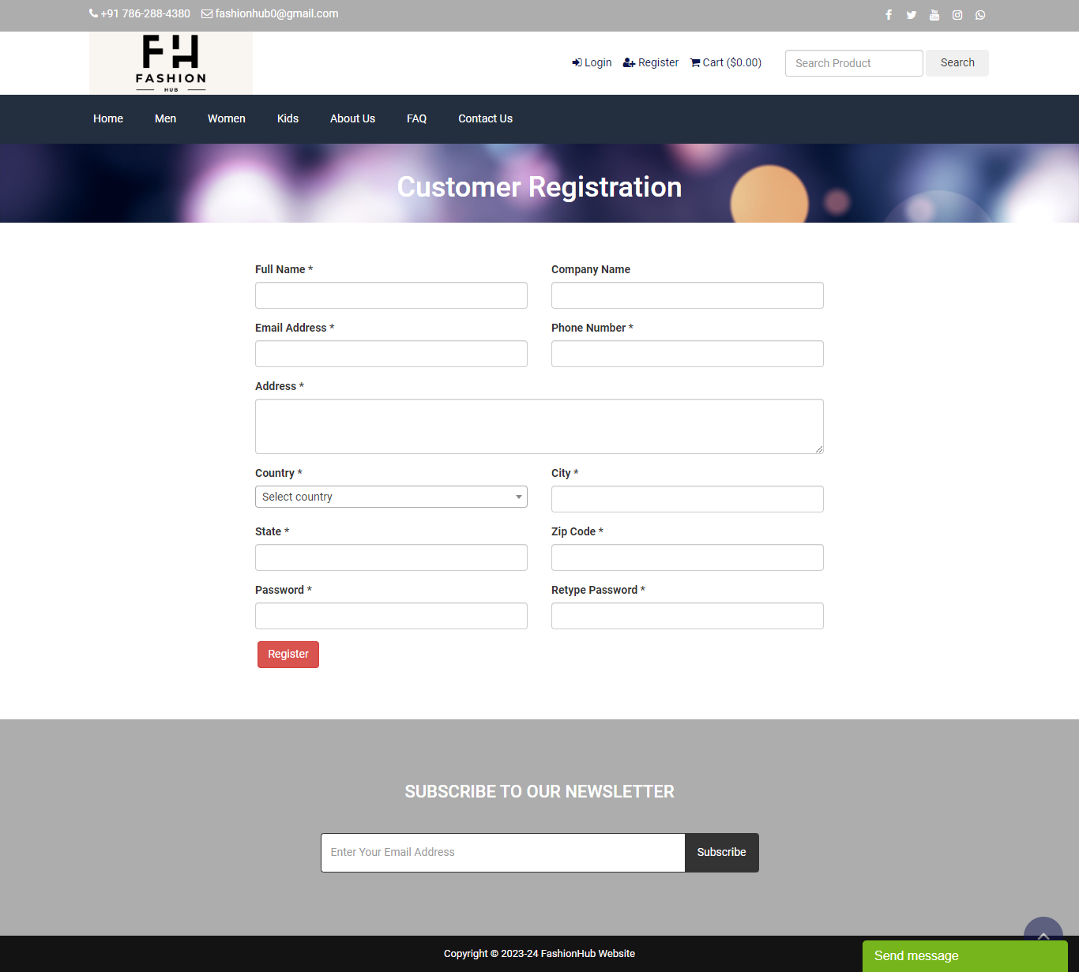
Seller site :
Login / Register :

Slide 39
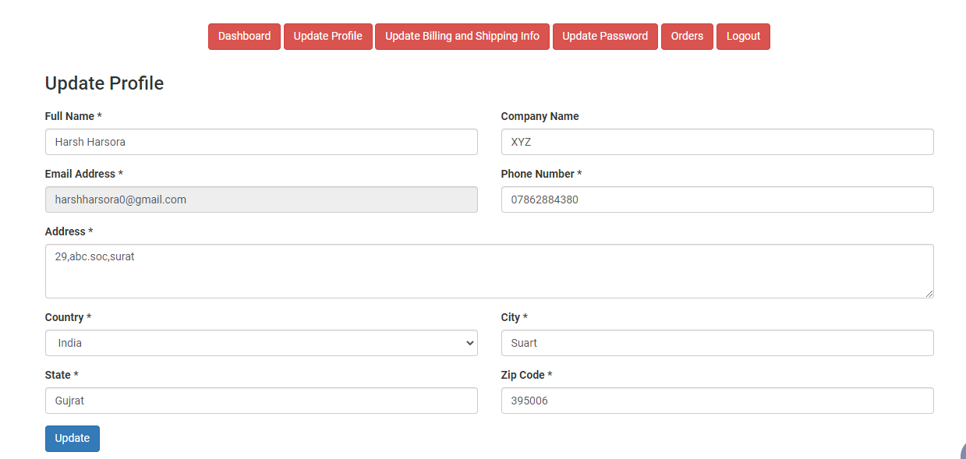
Dashboard :

Slide 40
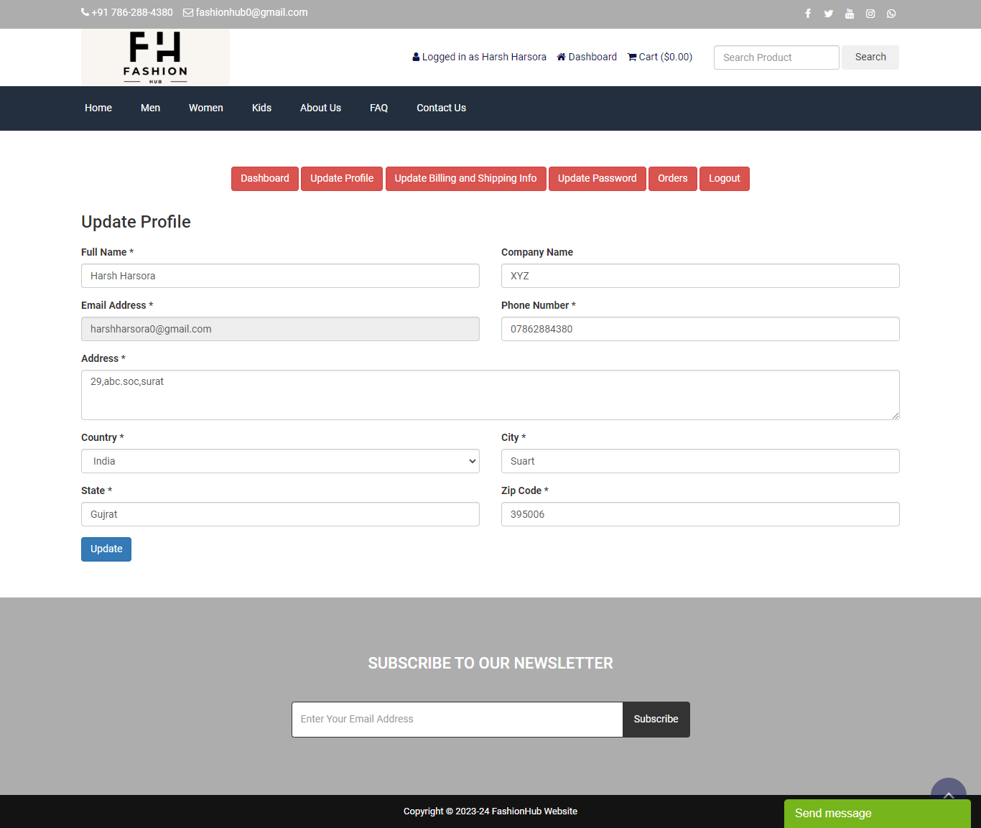
Profile :

Slide 41
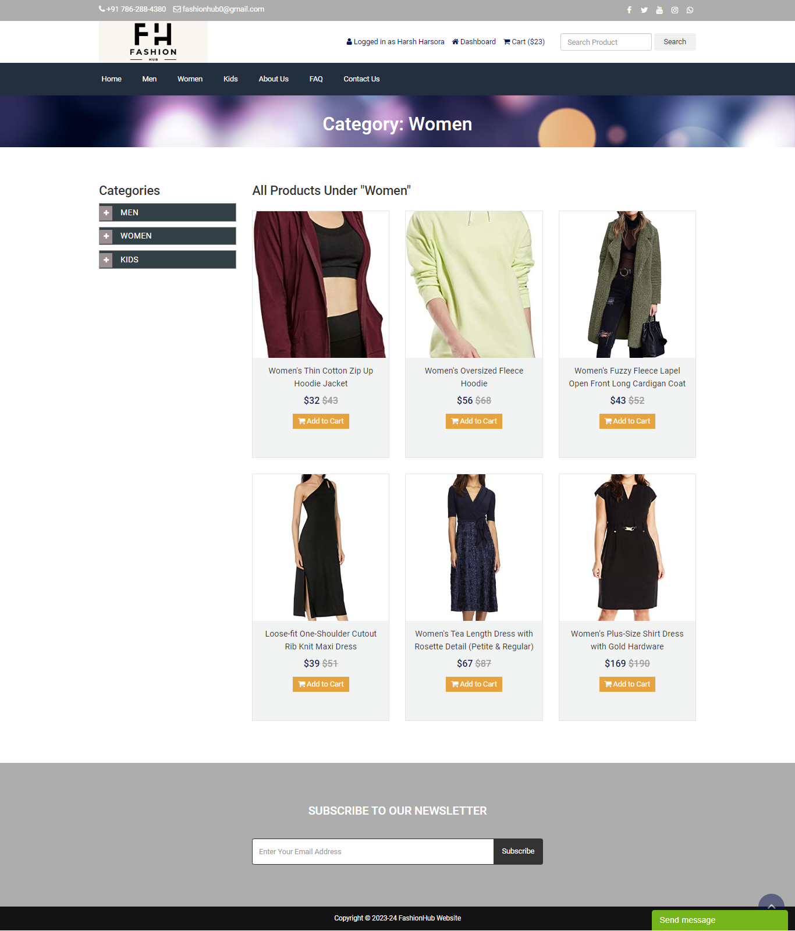
Add Product view:

Slide 42

View bills :

Slide 43

Product Details

Slide 44


User site :
Home :

Slide 45
Profile :

Slide 46

Address :

Slide 47

Orders :

Slide 48

Bills :

Slide 49
Product view :

Slide 50
Product Details :

Slide 51

Cart :

Slide 52
Placed orders :

Slide 53
References
www.flipkart.com
www.amazon.com
www.meesho.com
www.thefashionhub.net

Slide 54
Thank You!!

